Slide 1
Unit 1 Introduction to Java (Input-Processing-Output) Part 2 - Processing
ICS3U/ICS3C

Slide 2
Different Data Types
All of the information we have been outputting so far have been strings (Indicated by quotes “”)
Java can also output other types of values - both integer and float (decimal) numbers.

Slide 3
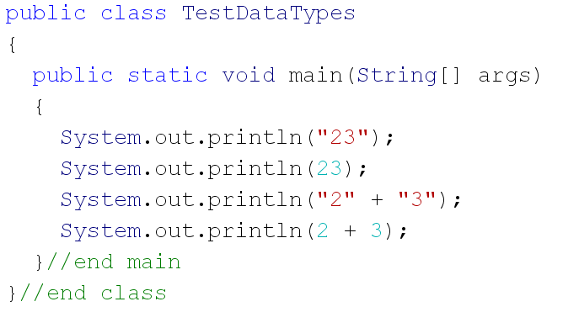
Different Data Types
Try out a program to output different data types:

Slide 4
Different Data Types
Notice how the 23 is in a different colour depending on the “ “

Slide 5
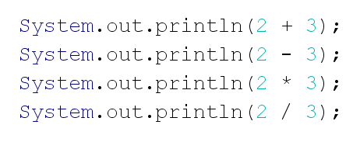
Other Math Operations...
Add to your program - try subtract, multiply and divide
Notice anything unusual with the last result??

Slide 6
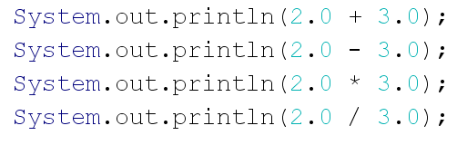
Other Math Operations...
The last example was using integers - try again with decimals
What is different with your output?

Slide 7
BEDMAS and Operations
Java follows order of operations for calculations
B - brackets E - exponents D - division and multiplication M A - addition and subtraction S

Slide 8
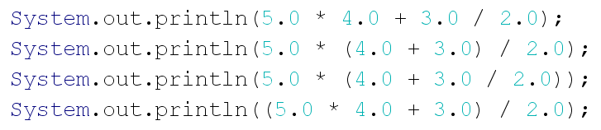
BEDMAS and Operations
Try these operations:
Be careful with “nested” brackets (brackets within brackets)

Slide 9
Data Types in Java
The first data type we used in our println statements were strings (for text).
Any strings in your code must be enclosed in quotes “ “

Slide 10
Numeric Data Types in Java
Java provides several different data types to store numeric values.
To decide which one to use, you need to determine whether you will need to store integers or real numbers (decimals) and also the size of the numbers you want to store

Slide 11
Integer Data Types in Java
We have four different data types to store integer values
They use a different number of bytes (space in memory) depending how large of values they can store
Using less memory is important for programs that must run quickly, or that store a large quantity of numbers
For our programs, storage space is not so important, we will usually use “int” (or “long” for very large values)

Slide 12
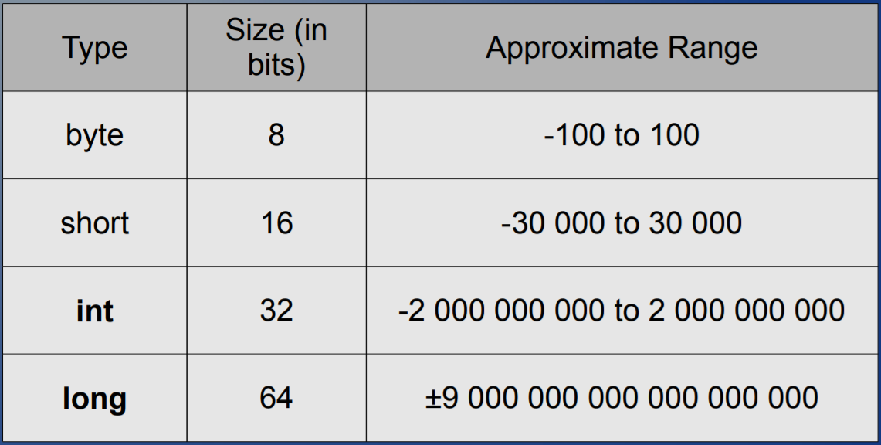
Integer Data Types in Java

Slide 13
Real Number Data Types in Java
There are two data types that store real numbers (decimal values)
Float can be a bit more efficient for space, but again, since that isn’t a big issue for our programs we will usually use double

Slide 14
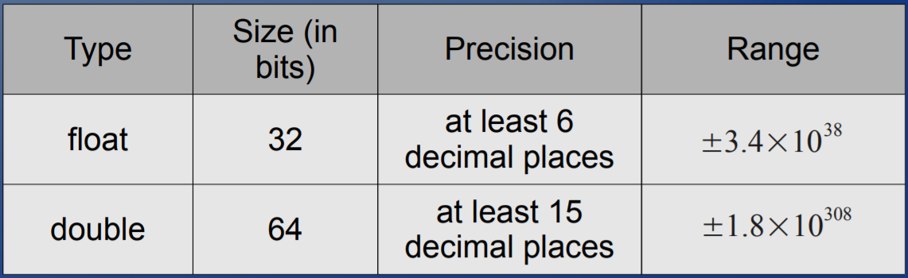
Real Number Data Types in Java

Slide 15
Other data types : char
this data type is similar to string in that it stores any text, but it holds only a single character
can be more efficient for memory
with char you will use single quotes ‘ ‘ instead of double quotes that are used on strings

Slide 16
Other data types : boolean
This data type holds a single bit of information (the smallest possible)
It holds a true or false value
The words “true” and “false” are reserved words in Java and can only be used to set the value for a boolean

Slide 17
Storing data - Using Variables
When we are using our data types to manipulate information or numeric values in our program, it is important to be able to save or store those values
We do this using variables

Slide 18
Storing data - Using Variables
Essentially, a variable is a name for a location in computer memory which uses a particular data type to hold a value.
To create a variable you need to know the data type, and give the variable a name

Slide 19
Naming Variables
We can choose the name of each variable we use
The variables must start with a letter (naming convention - start with lowercase)
Can include numbers and underscore
Convention - multiple word variables we use camelcase (first letter of first word lowercase, other words first letter uppercase) i.e. myFavouriteColour

Slide 20
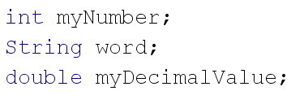
Declaring Variables
You must declare a new variable before you use it in your program - tell the computer the name and data type:

Slide 21
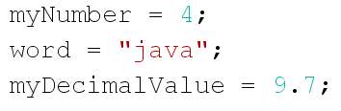
Initializing Variables
You can assign values to variables using an equals sign:
(note the quotes on our string value!!)

Slide 22
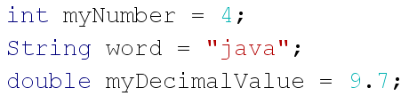
Initializing Variables
It is also possible to declare and initialize a variable in one line. This can be a good idea so that you don’t accidentally try to use a variable that hasn’t been initialized yet.

Slide 23
Printing Variables
You can include variables in your println statements
If you are combining variables with text, you need to concatenate them with a plus sign (+)

